Slide 1
Sql Server 2019: what’s new?

Slide 2
About me
Independent BI Consultant
Pluralsight author
Went from SQL Newb to SQL Pro

Slide 3
What are we going to cover?
Performance improvements
Availability and Security
SQL Server on Linux
MISC features
SQL Server Big Data Edition
Demos

Slide 4
Performance improvements
Scalar UDF in-lining (Demo)
Dynamic memory grants (Demo)
Batch execution mode (Demo)
Approximate distinct count (Demo)
Lightweight polling for query progress
Now enabled by default

Slide 5
availability
Accelerated Database Recovery
Resumable online index maintenance
Columnstore online index build and rebuild
Always On Availability Groups
5 synchronous replicas
Secondary replica connection redirection
(Connection redirection without a listener)

Slide 6
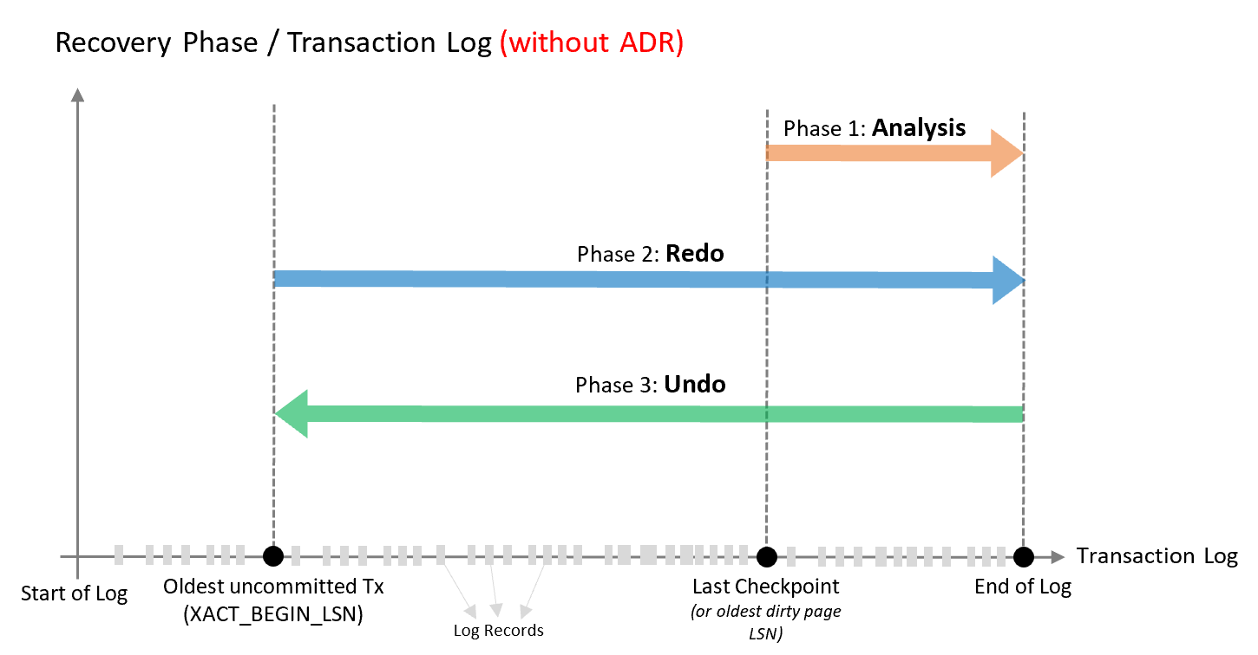
Recovery without ADR
Credit: Microsoft

Slide 7
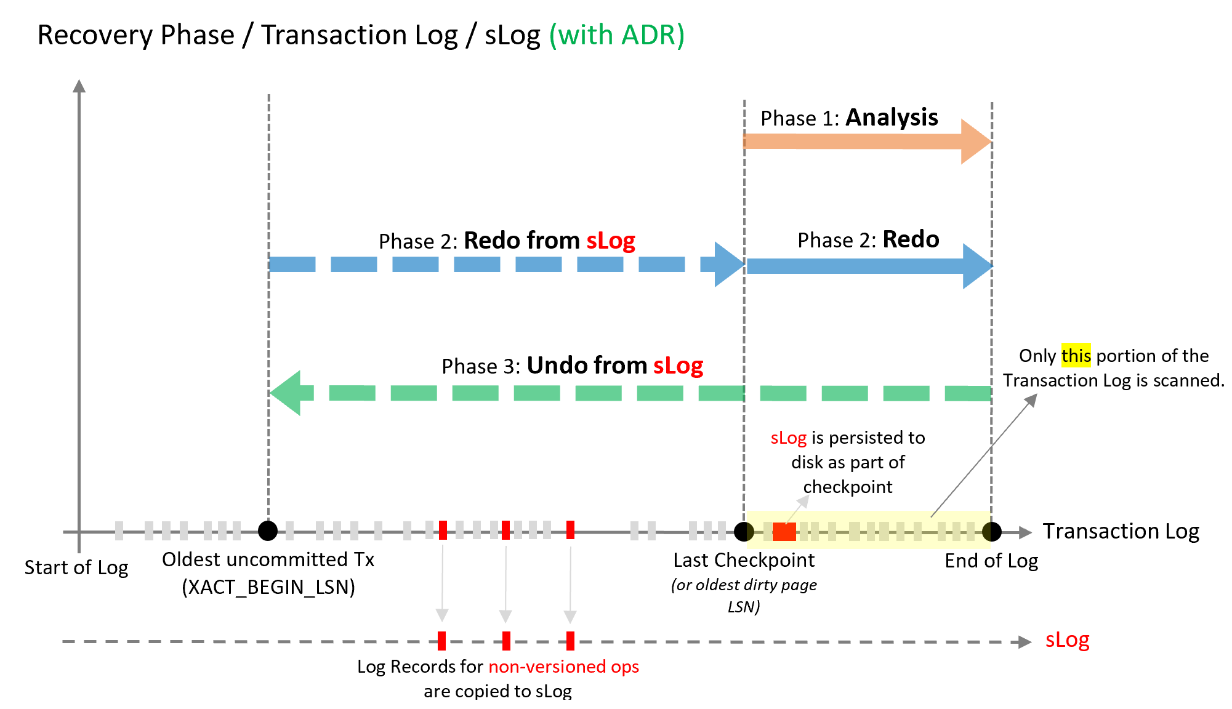
Recovery witH ADR
Credit: Microsoft

Slide 8
Security / privacy
Static Data Masking
Support for secure enclaves for Always Encrypted
In-place encryption
Rich computations – LIKE and range comparisons
SSL/TLS certificate management in the Configuration Manager

Slide 9
linux
Replication support
Transactional, snapshot and merge replication
Works as publisher, distributor or subscriber
Support for OpenLDAP
Machine Learning Services support
More container images available, RHEL certified images
Availability groups managed by Kubernetes
Microsoft Distributed Transaction Coordinator

Slide 10
Other features
String or binary data would be truncated (Demo)
UTF-8 support
Better data sizes for a limited set of scenarios
Java code support
New Polybase connectors for SQL Server, Oracle, Teradata, and MongoDB

Slide 11
Sql server big data edition
Data lives in HDFS (Hadoop file system)
Same storage system as Azure Data Lake
SQL and Apache Spark
Querying takes advantage of Polybase
Running in Linux containers
Orchestrated by Kubernetes

Slide 12
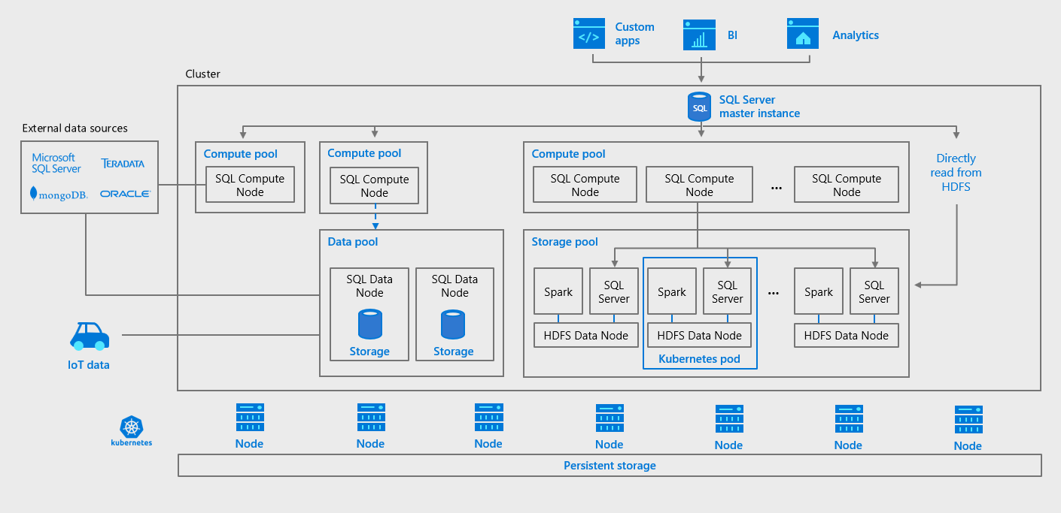
Credit: Microsoft

Slide 13
DEmos

