Slide 1
Introduction to power query
A.K.A The M Language

Slide 2
About me
BI Consultant
Went from SQL Newbie to SQL Pro in the last 7 years. Experience with T-SQL, SSRS, and Power BI.
Pluralsight Author
Author of video training on Pluralsight. Currently focusing on Power BI content.
Pittsburgh PUG Co-Leader
Help lead the Pittsburgh Power BI User Group.
/eugenemeidinger
@sqlgene
eugene@sqlgene.com

Slide 3
Agenda
We will cover the basics of Power Query and some language design
What is Power Query?
When should I use it?
How does it work?
Language Design
Demos, Demos, Demos

Slide 4
What is power query?
Power Query is a macro language for manual data manipulations
Power Query allows for taking a manual cleanup process and turning it into an automated, repeatable process
Power Query is a high level, declarative, dynamic, functional language
Similar to F#
More on this later
Follows the 80/20 rule of user interaction
80% of your needs can be done from the GUI

Slide 5
What does it look like?

Slide 6
When should I use it?
M stands for Menial labor and Manual data prep. (Well, not really)
If you could pay someone Minimum wage do to it in Excel, then the M language can automate it for you.
Official litmus test: “Users who get value from the Excel formula bar”.
Great for self-service data prep.
Can combine disparate data sources (CSV, Excel, SQL, Web)
If all your data lives in SQL, you probably don’t need it.

Slide 7
An analogy: cooking in the kitchen
If DAX is the head chef, M is the sous chef
A sous chef does the prep work.
Cleaning food, cutting vegetables, zesting, etc.
A head chef sets the direction.
Setting the menu, combining ingredients, etc.
M cleans the data (shaping the data, removing bad values, etc.)
DAX models the data (defining measures, associating tables, etc.)
There is some overlap between the two.

Slide 8
How does it work?
It all comes down to ETL
Extract
Transform
Load
M Engine
Extract – Load the data from different sources
Transform – Manipulate the data (replace values, pivot, add columns, etc.)
Load – Export the data
M Engine – Makes many decisions for us

Slide 9
An analogy: a warehouse floor
We’ve got four different roles to think about
Ed
Teresa
Larry
Melissa
Ed – Forklift driver and unboxer. Gets the raw materials.
Teresa – Assembly line worker. Does the bulk of the work.
Larry – Loads the finished goods for shipment.
Melissa – Manages the warehouse, determines the shape of the assembly.
We trust her to reorganize things as efficiently as possible.

Slide 10
Example M query
let
Source = Sql.Database("LOCALHOST", "AdventureWorks2014"),
Production_Product = Source{[Schema="Production",Item="Product"]}[Data],
#"Filtered Rows" = Table.SelectRows(Production_Product, each ([Color] = "Black")),
#"Removed Other Columns" = Table.SelectColumns(#"Filtered Rows",{"ProductID", "Name", "ProductNumber", "Color"})
in
#"Removed Other Columns"
Intimidating, right?

Slide 11
Applying roles
SQL
Filter on Black
Remove Columns
Output
let
Source = Sql.Database("LOCALHOST", "AdventureWorks2014"),
Production_Product = Source{[Schema="Production",Item="Product"]}[Data],
#"Filtered Rows" = Table.SelectRows(Production_Product, each ([Color] = "Black")),
#"Removed Other Columns" = Table.SelectColumns(#"Filtered Rows",{"ProductID", "Name", "ProductNumber", "Color"})
in
#"Removed Other Columns"

Slide 12
Data sources
Power Query supports a HUGE number of data sources
Files (CSV, Excel, JSON, XML, PDF)
Databases (SQL Server, Postgres, MySQL, Oracle)
Web (OData, HTML tables, JSON, XML)
Services (SharePoint, Exchange, etc.)

Slide 13
Data sources – Two different approaches
Power Query provides a lingua franca for your data
SSIS approach
29 data types!!!
Rigidly defined
Power Query approach
9 data types, 4 data structures
Checks occur at runtime, allows for nested data types
Minimalistic approach

Slide 14
Data sources – continued
The M language uses a minimal set of data types
Data Types:
Boolean
Number
Time, Date, DateTime, DateTimeZone, Duration
Text
Binary
Data Structures:
List
Record
Table
Function

Slide 15
Types of transformations
Data transformations are the bread and butter of Power Query
Combining data (merge, append, join)
Modifying columns (remove, split, create, rename, fill values down)
Modifying rows (promote headers, remove rows, remove duplicates)
String manipulation (uppercase, replace values, trim)
Other (pivot, unpivot, parse JSON/XML)

Slide 16
Where can it load into?
Anywhere DAX is used, M is not far behind
Excel add-in (Get and Transform)
Power BI (Query Editor)
SSAS 2017 (Data Sources)
Microsoft Flow (new!)
SSIS (In Preview)

Slide 17
Language features
M has a number of features that make it interesting as a language
Declarative language
Limited side-effects
Lazy evaluation
Query Folding

Slide 18
Why does it matter?
The M engine can make a significant number of optimizations
Declarative means we tell it what not how
Limited side-effects means reordering of steps is safe
Lazy evaluation means we only run what we need
Query Folding means offloading work to the database engine
These all allow for better performance

Slide 19
Query folding
SQL Filter on Black
Remove Columns
???
???
Output
Query folding is when we push work back to the database engine.
Teresa says to Ed, “Why don’t you just bring back the stuff that we need?”
Ed replies, “That would be more efficient, huh?”
Ed start only bringing the black parts they need. With nothing to do, Teresa now plays Minecraft 8 hours a day.

Slide 20
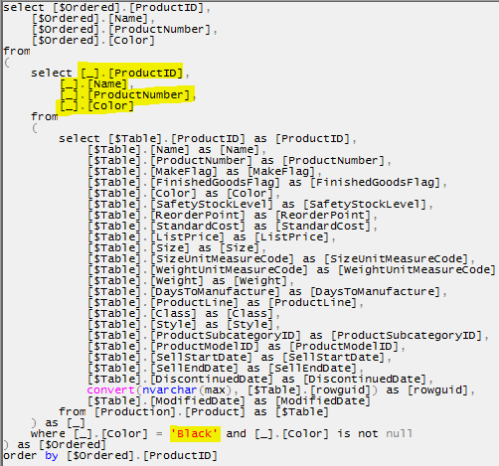
Query folding
Notes:
I tried to put this image into the laptop slide; the aspect ratio cut off the top and bottom of it, so I left it like this.

Slide 21
Power Query Demo

Slide 22
Thank You
Learn more from Eugene Meidinger
/eugenemeidinger
@sqlgene
eugene@sqlgene.com

