Slide 1
Keeping up With Technology: A Systems-based approach
Eugene Meidinger
@sqlgene
www.sqlgene.com/keepingup/
eugene@eugenemeidinger.com

Slide 2
Overview
Can you really keep up?
Why is keeping up an issue?
How do we model the problem?
How do we “Keep up?”
Learn more things
Learn the right things
Learn things that last longer

Slide 3
Betteridge's law of headlines
Any headline that ends
in a question mark
can be answered
by the word no.

Slide 4
Can we keep up with technology?
No.

Slide 5
Why not?
Keeping up is ill-definied
More of a vague fear than a structured goal
You are never “done”
More of an emotional problem
The rate of change is accelerating
Many cloud technologies change every month, every week
In the data space this is very true, especially with “NoSQL”

Slide 6
What’s the real question?
How do I keep my friends?
How do I keep my job?

Slide 7
What’s the real goal?
Learning Efficiently
Learning Effectively

Slide 8
What can we do?
Maximize our resources for learning
Make our learning more efficient
Increase how long our knowledge stays relevant
In short, make the most of what we’ve got

Slide 9
Systems thinking

Slide 10
A simple system: a bath tub
Faucet
Tub
Drain

Slide 11
A simple system: a bath tub
Water Utility
Faucet
Tub
Drain
Sewer

Slide 12
Why do we have to learn new things?
New stuff comes out
Vue
Ethereum
Swift
Old stuff gets old
MooTools
Relational databases (kidding!)
Cobol
Notes:
Animation for header level

Slide 13
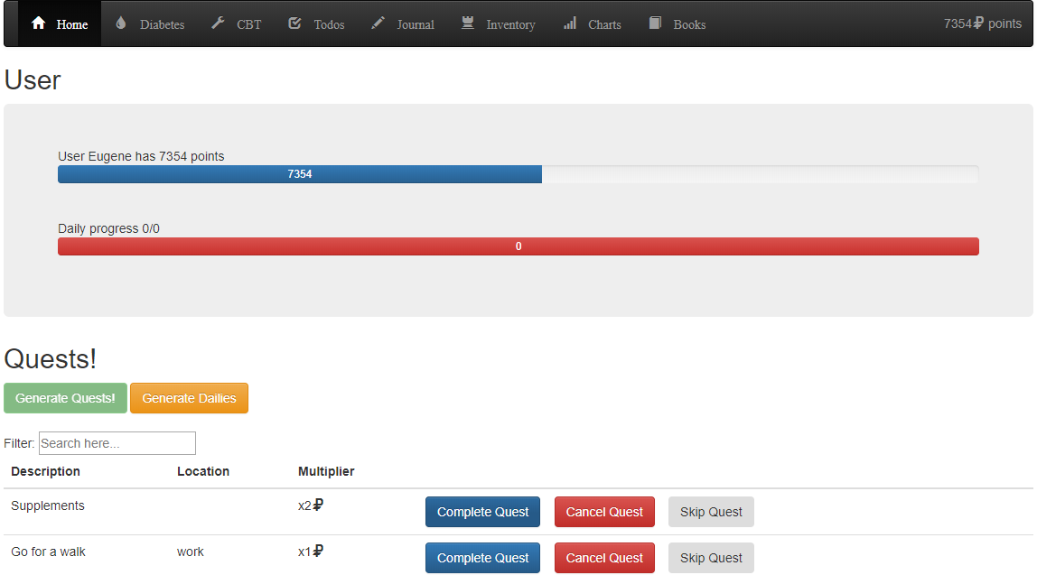
Why do we have to learn new things?
Notes:
Animation for header level

Slide 14
Your knowledge system
New stuff (React)
Faucet
Relevant (HTML)
Drain
Old Stuff (AngularJS)

Slide 15
An analogy: investing
Inflation means our money is worth less every year
To avoid inflation, we invest in stocks, not bonds
Volatility means our investments could implode
To avoid volatility, we diversify our investments
Notes:
Animation

Slide 16
Financial Risks
Inflation
Volatility
Hurts you slowly
Hurts you quickly

Slide 17
Career Risks
Old Tech
New Tech
Hurts you slowly
Hurts you quickly

Slide 18
Career Risks
VHS
HD-DVD
Hurts you slowly
Hurts you quickly

Slide 19
Career Risks
VB6
Kubernetes
Hurts you slowly
Hurts you quickly

Slide 20
“In an immature market, generalize.
In a mature market, specialize”
- Buck Woody

Slide 21
Immature markets are high volatility
Mature markets are low growth

Slide 22
The contradiction of learning
To add value, we need to specialize
No one wants a true jack of all trades
To avoid becoming irrelevant, we need to generalize
Both require different resources and learning styles
Generalization costs time and short-term risk
Specialization costs focus/money and long term risk

Slide 23
Go Deep
Go Wide
To keep your job
To pay the bills

Slide 24
Specialization is always harder
You can generalize via passive learning
Blogs
Podcasts
Codemash general sessions
You can’t specialize via passive learning; you have to
Present
Write
Do home labs

Slide 25
An analogy: Radioactive decay
In nuclear physics, there is the idea of a half-life
A half-life is the time is takes to halve of the original amount
IT knowledge can be modeled as a half-life
How long before half of what you know is useless?

Slide 26
“Every 5 years,
you have to retool yourself”
-Allen White

Slide 27
Every 5 years, half of what you know is obsolete
How do we mathematically model this?
Rate of decay ^ 5 years = ½ your knowledge
X^5 = 0.5
X = 0.87
Every year, 87% of what you know is still relevant
Every year, 13% of what you know is irrelevant

Slide 28
“Every year, 13% of what you know becomes irrelevant”
-Me

Slide 29
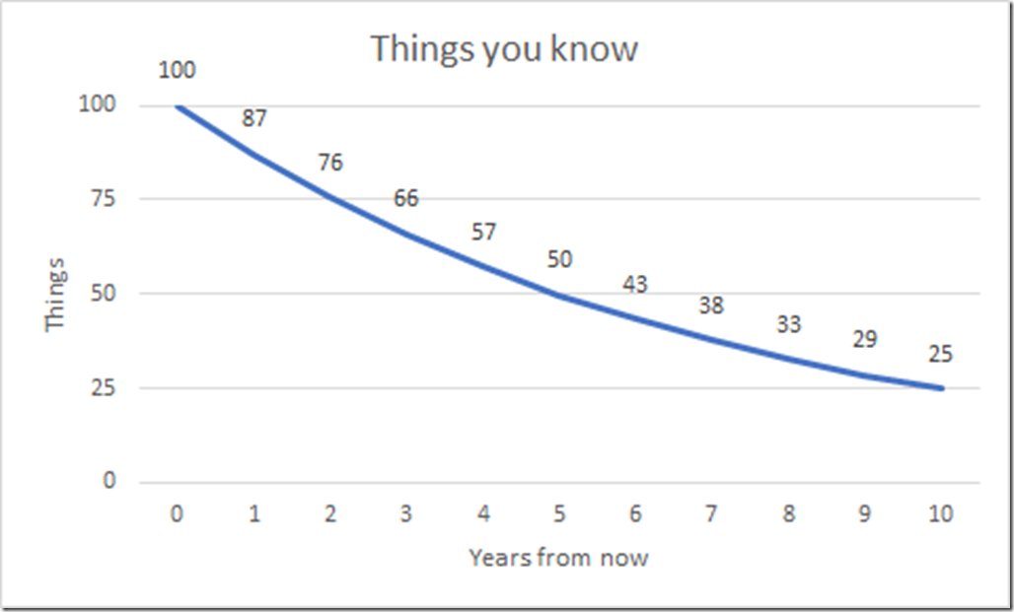
What does that look like?

Slide 30
That’s a 13% interest rate
That’s going from an A+ to a B
That’s crazy
That’s scary
How can we fix it?

Slide 31
We have 3 options
Learn more things
Learn more of the right things
Learn more of the things that last longer

Slide 32
How to fix it
New stuff (React)
More
Faucet
Relevant (HTML)
Less
Less
Drain
Old Stuff (AngularJS)
Wrong stuff (Blockchain)

Slide 33
The costs of learning
Time
Energy
Money

Slide 34
Time
Cut things out
Where are you spending your time?
Do a time audit
Use Toggl.com
Multi-task
Listen to podcasts while you drive, exercise, wash dishes
Utilize dead time
The “10 minutes in the doctor’s office”
Read Feedly instead of reading Twitter, playing Candy Crush

Slide 35
Energy /Focus
Create a learning space
Schedule time
Remove distractions
Know your bodily cycles
Take care of yourself
Diet
Exercise
Sleep

Slide 36
Focus - apps
Pomodoros
Leechblocker (Firefox)
StayFocusd (Chrome)
Nanny (Chrome)
Appblock – Stay focused (Android)
Beeminder

Slide 37
Money
Of the 3 resources, money is the most plentiful

Slide 38
Money
Don’t be afraid to spend money on learning
Curation is essential
Good learning materials can save you energy and focus
Budget your money
You Need a Budget
Mint.com
EveryDollar.com

Slide 39
Learn the right things
New stuff (React)
Faucet
Relevant (HTML)
Less
Drain
Old Stuff (AngularJS)
Wrong stuff (Blockchain)

Slide 40
Learning the right things
Increase the signal to noise ratio
Have a learning plan
Focus on depth and specialization

Slide 41
Increase the signal to noise ratio
Don’t depend on Twitter and Hacker news
Otherwise you’ll learn about politics and Uber
Lean on curation
Feedly
Pluralsight / Linkedin Learning
Books
Learn the things in your plan

Slide 42
Have a learning plan
Read job postings
Consider certifications
Put together a plan
What’s your 1 year goal?
What’s your 3 year goal?
Work your plan

Slide 43
Focus on depth and specialization
Exposure and generalization requires learning the wrong things
Exposure is about unknown unknowns
By definition, the noise level is high
If you know you need to learn a specific area, going deep has a higher chance of paying off
Mastery and expertise is about known unknowns
By definition, there is a higher chance of payoff

Slide 44
Learn things that last
New stuff (React)
Faucet
Relevant (HTML)
Less
Drain
Old Stuff (AngularJS)
Wrong stuff (Blockchain)

Slide 45
Learn things that last
Avoid volatile skill sets
Go deep
Learn things that are timeless
Learn things that transfer

Slide 46
Soft skills are timeless
Learn technical writing
Learn communication
Learn project management

Slide 47
Soft skills – resources
Presenting
Toastmasters
User groups
Books
Win friends and influence people
How to Have Confidence and Power in Dealing with People
Crucial conversations
Podcast
Career tools / Manager tools

Slide 48
Deep dives last longer
Learn fundamentals
Learn theory
Learn internals

Slide 49
Questions?
http://sqlgene.com/keepingup/
@sqlgene
eugene@eugenemeidinger.com

