Slide 1
Power BI Deployment: Scaling from 5 to 5000
Eugene Meidinger
@sqlgene / sqlgene.com

Slide 2
About me
Business Intelligence Consultant
Worked for All Lines Technology for 6 years
Speak at various SQL Saturdays and online
Pluralsight author
Help lead the Pittsburgh Power BI user group
Went from SQL newb to SQL pro

Slide 3
Why Talk About Deployment Methods?
It keeps changing!
Group workspaces were rebranded as Apps
Power BI Embedded V1 is dead
Organizational Content Packs are dying
Premium and On-Prem were added last year
Report Sharing was announced yesterday
SharePoint Embedding went GA yesterday
It’s confusing!
There are a large, varied set of ways to deploy

Slide 4
The Many Ways to Deploy Power BI
Dashboard Sharing
Shared Workspaces
Organization Content Packs
Apps
SharePoint Embedding
Power BI Premium
Publish To Web
Power BI Report Server
Power BI Embedded

Slide 5
Scaling Up and Out
Public
Organization
PBI Users
Team

Slide 6
Self-Service BI versus IT Governance
IT Governance (High Scale)
Self-Service BI (Small Scale)

Slide 7
Sharing with Your Team
5000
500
50
5

Slide 8
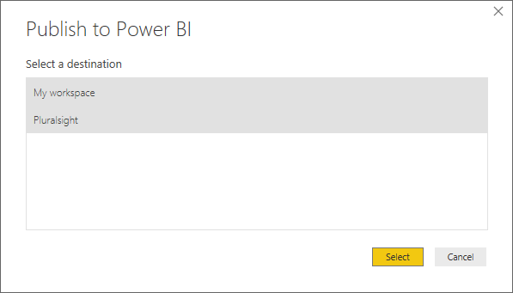
Basic Publishing

Slide 9
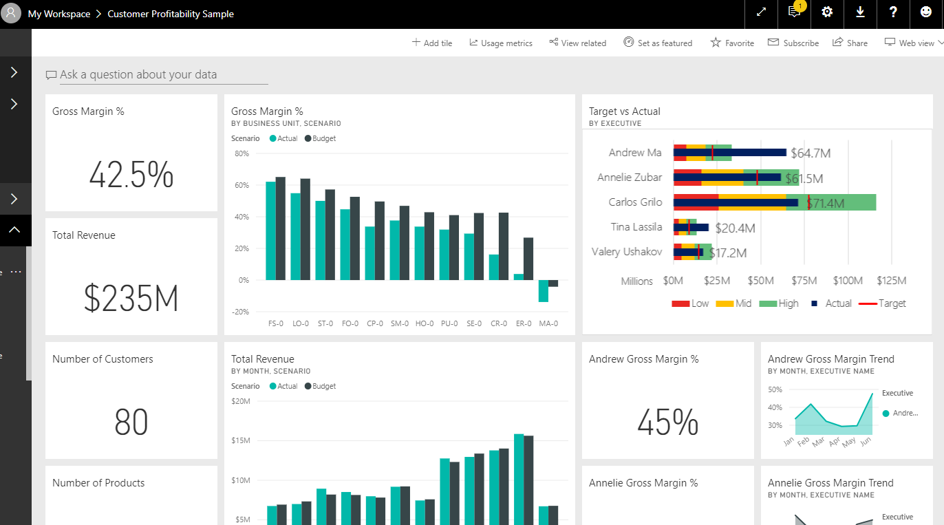
Dashboard Sharing
Easiest and quickest way to share
Requires creating a dashboard
A dashboard is basically a Pinterest board for your reports
Only provides three permission levels
Owner
Read
Read and Share

Slide 10
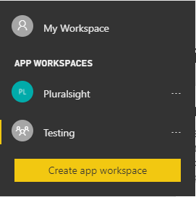
Shared Workspace
Create a workspace
Creates an Office 365 Group
Gives other users access to Dashboards, Reports & Datasets
Two levels of Permission
Admin
Member
Members can be set to read-only

Slide 11
Sharing with All Power BI Users
5000
500
50
5

Slide 12
Organizational Content Packs
Organizational content packs are DEPRECATED
Replaced by Apps
Only ideal for report templating
Allows users to make a copy
User then safely customize reports

Slide 13
Power BI Apps
Power BI App = Shared workspace + Publishing
Official replacement for
Group Workspaces
Organization Content Packs
Allows for Staging and QA
Allows for selective publishing
THE method for sharing with all Power BI Users in Org
Actual sharing is done via URL / Searching currently

Slide 14
Sharing with Your Organization
5000
500
50
5

Slide 15
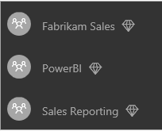
Power BI Premium
VERY EXPENSIVE
Starting at $5000 per month
Licenses capacity, not users
Ideal for
Large user bases
Large data sets
High performance
User experience is exactly the same
More about licensing than deployment
Source: Microsoft

Slide 16
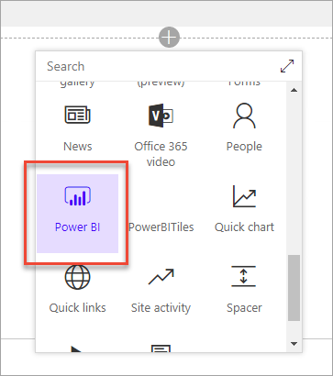
SharePoint Embedding
Shows report as Web Part
Licensing requires:
Power BI Pro
Or, Premium (EM SKUs)
$625-$2495 per month
300-1200 renders per hour
Left preview yesterday
Source: Microsoft

Slide 17
Power BI Report Server
Basically SSRS with Power BI support
Expensive to license
Power BI Premium
OR, Enterprise Edition with SA
Limited support
No scheduled refresh
No Dashboards
No QA / Cortana
Custom Power BI Desktop (Updated Quarterly)

Slide 18
Sharing with Everyone
5000
500
50
5

Slide 19
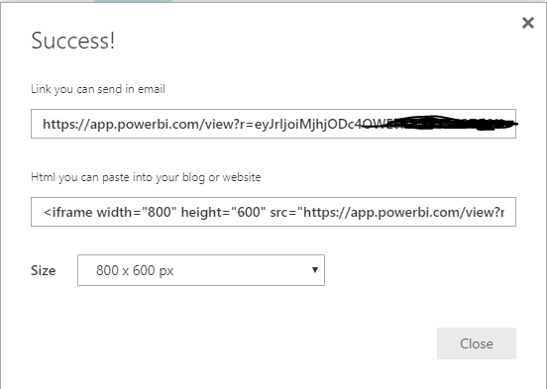
Publish to Web
Free to use
Makes the data PUBLICLY AVAILABLE
To anyone with the URL
Can be disabled by tenant / security group
Creates an embeddable iframe for a website

Slide 20
Power BI Embedded
Requires a Web Developer to implement
Depends on Premium Capacity
Cheaper SKUS Are available
$725-$23,000 per month
300-9600 renders per hour
Custom security model

Slide 21
Recapping
Power BI Embedded / Publish To Web
Dashboards Workspaces
Premium / Report Server / SharePoint
Apps

Slide 22
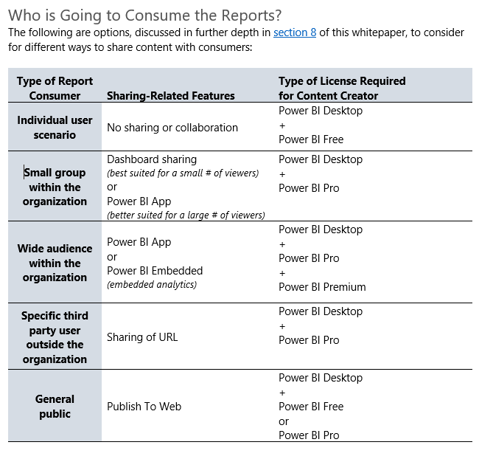
What next?
Deployment Whitepaper
https://docs.microsoft.com/en-us/ power-bi/whitepapers
Written by:
Chris Webb
Melissa Coates

Slide 23
PASS Content Survey
Win free admission
Closes Feb 14th, 2018
https://www.surveymonkey.com/r/SQPVFNV

