Slide 1
Keeping up With Technology: Drinking From the Firehose
Eugene Meidinger
@sqlgene
www.sqlgene.com/keepingup/
eugene@eugenemeidinger.com

Slide 2
About me
Business Intelligence developer
Worked for All-Lines for 5 years
Spoken at Pittsburgh SQL User Group and various SQL Saturdays
Help lead the Pittsburgh Power BI User Group
Pluralsight Author
Went from SQL newb to SQL pro

Slide 3
Overview
Can you really keep up?
Why is keeping up an issue?
How do we model the problem?
How do we “Keep up?”
Learn more things
Learn the right things
Learn things that last longer

Slide 4
Betteridge's law of headlines
Any headline that ends
in a question mark
can be answered
by the word no.

Slide 5
Can we keep up with technology?
No.

Slide 6
Why not?
Keeping up is ill-definied
More of a vague fear than a structured goal
You are never “done”
More of an emotional problem
The data platform is broadening
Data Science
Big Data
NoSQL
The rate of change is accelerating
SQL Server 2017 is coming out

Slide 7
What’s the real question?
How do I keep my friends?
How do I keep my job?

Slide 8
What’s the real goal?
Learning Efficiently
Learning Effectively

Slide 9
What can we do?
Maximize our resources for learning
Make our learning more efficient
Increase how long our knowledge stays relevant
In short, make the most of what we’ve got

Slide 10
Why do we have to learn new things?
New stuff comes out
SQL Server 2017
JSON support
PowerBI
Old stuff gets old
SQL Server 2000
DTS
Performance Point
Notes:
Animation for header level

Slide 11
An analogy: investing
Inflation means our money is worth less every year
To avoid inflation, we invest in stocks, not bonds
Volatility means our investments could implode
To avoid volatility, we diversify our investments
Notes:
Animation

Slide 12
Financial Risks
Inflation
Volatility
Kills you slowly
Kills you quickly

Slide 13
Career Risks
Old Tech
New Tech
Kills you slowly
Kills you quickly

Slide 14
Career Risks
VHS
HD-DVD
Kills you slowly
Kills you quickly

Slide 15
Career Risks
VB6
Hadoop
Kills you slowly
Kills you quickly

Slide 16
“In an immature market, generalize.
In a mature market, specialize”
-Abraham Lincoln
- Buck Woody

Slide 17
Immature markets are high volatility
Mature markets are low growth

Slide 18
The contradiction of learning
To add value, we need to specialize
No one wants a true jack of all trades
To avoid becoming irrelevant, we need to generalize
Both require different resources and learning styles
Generalization costs time and short-term risk
Specialization costs focus/money and long term risk

Slide 19
Go Deep
Go Wide
To keep your job
To pay the bills

Slide 20
Specialization is always harder
You can generalize via passive learning
Blogs
Podcasts
SQL Saturdays / GroupByConf
You can’t specialize via passive learning; you have to
Present
Write
Do home labs

Slide 21
An analogy: Radioactive decay
In nuclear physics, there is the idea of a half-life
A half-life is the time is takes to halve of the original amount
IT knowledge can be modeled as a half-life
How long before half of what you know is useless?

Slide 22
“Every 5 years,
you have to retool yourself”
-Allen White

Slide 23
Every 5 years, half of what you know is obsolete
How do we mathematically model this?
Rate of decay ^ 5 years = ½ your knowledge
X^5 = 0.5
X = 0.87
Every year, 87% of what you know is still relevant
Every year, 13% of what you know is irrelevant

Slide 24
“Every year, 13% of what you know becomes irrelevant”
-Me

Slide 25
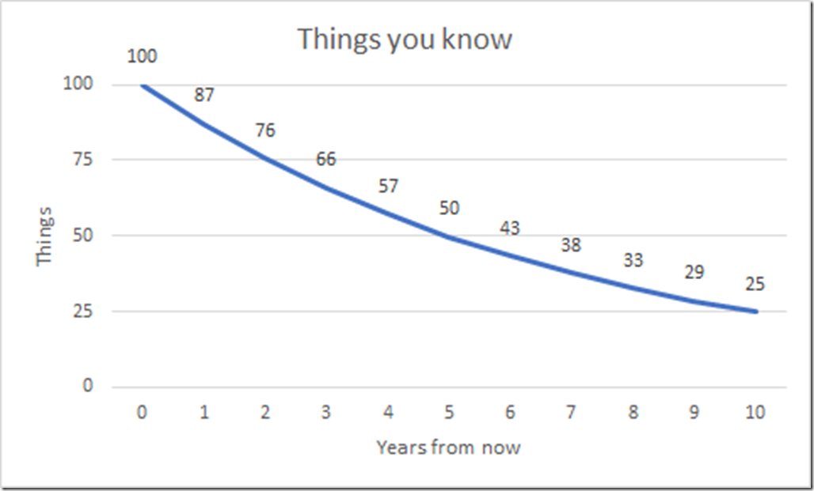
What does that look like?

Slide 26
That’s a 13% interest rate
That’s going from an A+ to a B
That’s crazy
That’s scary
How can we fix it?

Slide 27
We have 3 options
Learn more things
Learn more of the right things
Learn more of the things that last longer

Slide 28
Learn more things
What are the costs of learning?
Time
Energy
Money

Slide 29
Time
Cut things out
Where are you spending your time?
Do a time audit
Use Toggl.com
Multi-task
Listen to podcasts while you drive, exercise, wash dishes
Utilize dead time
The “10 minutes in the doctor’s office”
Read Feedly instead of reading twitter, playing Candy Crush

Slide 30
Multitasking – podcasts
Data driven
Dear SQL DBA
GroupBy Podcast
Office hours
SQL data Partners
SQL Server Radio

Slide 31
Focus
Create a learning space
Schedule time
Remove distractions
Know your bodily cycles
Take care of yourself
Diet
Exercise
Sleep

Slide 32
Focus - apps
Pomodoros
Leechblocker (Firefox)
StayFocusd (Chrome)
Nanny (Chrome)
Beeminder

Slide 33
Money
Of the 3 resources, money is the most plentiful

Slide 34
Money
Don’t be afraid to spend money on learning
Curation is essential
Good learning materials can save you energy and focus
Budget your money
You Need a Budget
Mint.com
EveryDollar.com

Slide 35
Learning the right things
Increase the signal to noise ratio
Have a learning plan
Focus on depth and specialization

Slide 36
Increase the signal to noise ratio
Don’t depend on Twitter and Hacker news
Otherwise you’ll learn about politics and Uber
Lean on curation
Feedly
Pluralsight
Books
Learn the things in your plan

Slide 37
Have a learning plan
Read job postings
Consider certifications
Put together a plan
What’s your 1 year goal?
What’s your 3 year goal?
Work your plan

Slide 38
Focus on depth and specialization
Exposure and generalization requires learning the wrong things
Exposure is about unknown unknowns
By definition, the noise level is high
If you know you need to learn a specific area, going deep has a higher chance of paying off
Mastery and expertise is about known unknowns
By definition, there is a higher chance of payoff

Slide 39
Learn things that last
Avoid volatile skill sets (*cough* Angular *cough*)
Go deep
Learn things that are timeless
Learn things that transfer

Slide 40
Soft skills are timeless
Learn technical writing
Learn communication
Learn project management

Slide 41
Soft skills – resources
Presenting
Toastmasters
User groups
Books
Win friends and influence people
How to Have Confidence and Power in Dealing with People
Crucial conversations
Podcast
Career tools / Manager tools

Slide 42
Deep dives last longer
Learn fundamentals
Learn theory
Learn internals

Slide 43
Recap – 8 keys
Use multitasking to get more time
Take care of yourself
Schedule time
Spend money on curation
Understand specialization versus generalization
Pick a specialization
Make a plan
Learn things that last

