Slide 1
An (Advanced) Introduction to DAX
Eugene Meidinger
@sqlgene
www.sqlgene.com/powerbi/
emeidinger@all-lines-tech.com

Slide 2
About me
Business Intelligence developer
Worked for All-Lines for 5 years
Spoken at Pittsburgh SQL User Group and various SQL Saturdays
Help lead the Pittsburgh Power BI User Group
Pluralsight Author
Went from SQL newb to SQL pro

Slide 3
What is the goal of this talk?
Focus on core concepts
Building the basic mental model
What is difficult to understand?

Slide 4
DAX is NOT X
DAX is not Excel
DAX is not SQL
DAX is not MDX
DAX is painful if you don’t get this
The concepts are harder than the syntax

Slide 5
Learning Curve (The Problem With DAX)
Evaluation contexts
Nesting evaluation contexts
Time Intelligence
Difficulty
Filtering
Scalar functions
Measures
Calculated columns
Functionality

Slide 6
This Course’s Focus
Evaluation contexts
Nesting evaluation contexts
Time Intelligence
Difficulty
Filtering
Scalar functions
Measures
Calculated columns
Functionality

Slide 7
Overview
Calculated columns vs measures
Columnar storage
Aggregations
Filtering
Filter contexts
Iterators

Slide 8
There are two types of business logic
Calculated columns
Measures

Slide 9
Calculated columns
Represents a single value per row
Computed at time of creation/refresh
Results are materialized and stored with the table
Attached to a specific table
Normally can only see the row they exist in
Relates to the idea of row context
More on this later
Can be used in filters or values/results areas

Slide 10
Example Calculated Column
GrossMargin = Sales[Price] – Sales[Cost]

Slide 11
Measures
Represents a single value per data model
Computed at run time
Results are dynamic, based on filters
This is called the filter context
Not attached to any table
Sees all the data at once

Slide 12
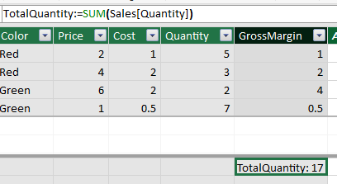
Example Measure
TotalQuantity := SUM(Sales[Quantity])

Slide 13
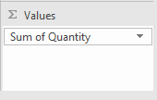
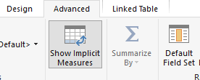
Implicit measures
If you use a calculated column as a value/result it creates an implicit measure

Slide 14
DAX is good at two things
Aggregations
Filtering

Slide 15
What is an aggregation?
Aggregation is combining a group of values into one value
Examples
SUM
AVERAGE
MIN
MAX
DISTINCTCOUNT

Slide 16
Quantity
4
1
3
2
7
5
1
SUM(Quantity)
23

Slide 17
DAX stores data as columns
Super efficient for simple aggregations
Many aggregate functions take columns as parameters
DAX is optimized for single-column operations
Columns are the fundamental unit of measure

Slide 18
Color
Blue
Green
Green
Red
Red
Red
Red
State
PA
OH
WV
PA
OH
WV
OH
Quantity
1
5
2
3
5
6
2

Slide 19
Color
Blue
Green
Green
Red
Red
Red
Red
State
PA
OH
WV
PA
OH
WV
OH
Quantity
4
1
3
2
7
5
1

Slide 20
Basic units of measure
Column
Table
A set of columns with the same length and sort order
Scalar Value
Row
A table filtered down to a single row
Also called a row context

Slide 21
Compression and encoding
Value Encoding
Dictionary Encoding
Run-length encoding
Sorting

Slide 22
Color
Blue
Green
Green
Red
Red
Red
Red
Color
Blue,1
Green,2
Red, 4

Slide 23
DAX is good at two things
Aggregations
Filtering

Slide 24
Two types of Filtering
Implicit filtering
Explicit filtering

Slide 25
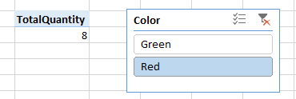
Implicit Filtering
Slicers
Cell Location

Slide 26
Explicit Filtering
GreenQuantity := CALCULATE(SUM(Sales[Quantity]), Sales[Color]="Green")
Explicit filtering supersedes implicit filtering

Slide 27
Filtering Context
A combination of all the user filters
Basic filters are associated with specific, individual columns
CALCULATE allows you to overwrite the filter context

Slide 28
Removing Filtering
The ALL() function removes filters
Can be used on a whole table, or specific columns
AllColors:=CALCULATE(SUM(Sales[Quantity]), ALL(Sales[Color]))

Slide 29
Applying complex filtering
This causes an error:
CALCULATE(SUM(Sales[Quantity]), Sales[Price] - Sales[Cost] <= 1)
Need to use something called an “iterator”
FILTER() takes in a table and an expression
Returns a filtered table

Slide 30
Example FILTER()
LowMargin:=CALCULATE(SUM(Sales[Quantity]),FILTER(Sales, Sales[Price] - Sales[Cost] <= 1))

Slide 31
Iterators
Process tables row by agonizing row
Expensive to process
Rows are filtered one at a time.
Called a row context
Often a filter context AND a row context is applied
Necessary to refer to multiple fields in the same row
SUM(Sales[Price] - Sales[Cost]) raises an error

Slide 32
Example Iterator
AverageGrossMargin1:=AVERAGE(Sales[GrossMargin])
AverageGrossMargin2:=AVERAGEX(Sales, Sales[Price] - Sales[Cost])
Requires a table parameter to “iterate” through
Iterators are expensive

Slide 33
Key concepts
Calculated columns are materialized values in a table
Measures look at all the data plus the filter context
Explicit filtering overrides implicit filtering
DAX is optimized for single-column operations
Rows don’t exist, but row contexts do
Multi-column operations require iterators, which are expensive
CALCULATE() + FILTER() / ALL() can be used to apply advanced filtering

Slide 34
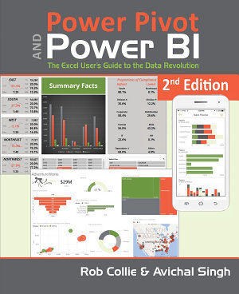
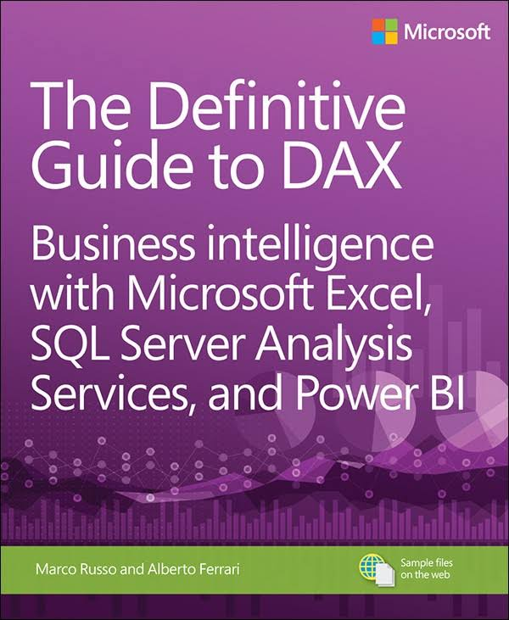
Book Recommendations

Slide 35
Questions?
Contact Info
@sqlgene
www.sqlgene.com/powerbi/
emeidinger@all-lines-tech.com

