Slide 1

An (Advanced) Introduction to DAX
Eugene Meidinger
@sqlgene
www.sqlgene.com/powerbi/
emeidinger@all-lines-tech.com

Slide 2
About me
Business Intelligence developer
Worked for All-Lines for 5 years
Spoken at Pittsburgh SQL User Group and various SQL Saturdays
Help lead the Pittsburgh Power BI User Group
Pluralsight Author
Went from SQL newb to SQL pro

Slide 3
What is the goal of this talk?
Focus on core concepts
Building the basic mental model
What is difficult to understand?

Slide 4
Overview
Calculated columns vs measures
Columnar storage
Aggregations
Filtering
Filter contexts
Iterators

Slide 5
DAX is NOT X
DAX is not Excel
DAX is not SQL
DAX is not MDX
DAX is painful if you don’t get this
The concepts are harder than the syntax

Slide 6
There are two types of business logic
Calculated columns
Measures

Slide 7
Calculated columns
Represents a single value per row
Computed at time of creation/refresh
Results are materialized and stored with the table
Attached to a specific table
Normally can only see the row they exist in
  Relates to the idea of row context
  More on this later
Can be used in filters or values/results areas

Slide 8
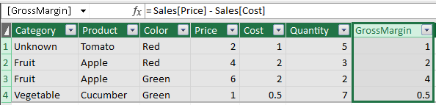
Example Calculated Column
GrossMargin = Sales[Price] – Sales[Cost]

Slide 9
Measures
Represents a single value per data model
Computed at run time
Results are dynamic, based on filters
  This is called the filter context
Not attached to any table
Sees all the data at once

Slide 10
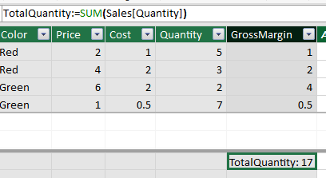
Example Measure
TotalQuantity := SUM(Sales[Quantity])

Slide 11
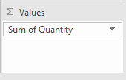
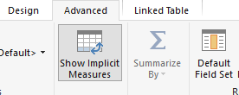

Implicit measures
If you use a calculated column as a value/result it creates an implicit measure

Slide 12
DAX is good at two things
Aggregations
Filtering

Slide 13
What is an aggregation?
Aggregation is combining a group of values into one value
Examples
  SUM
  AVERAGE
  MIN
  MAX
  DISTINCTCOUNT

Slide 14
Quantity
4
1
3
2
7
5
1
SUM(Quantity)
23

Slide 15
DAX stores data as columns
Super efficient for simple aggregations
Many aggregate functions take columns as parameters
DAX is optimized for single-column operations
Columns are the fundamental unit of measure

Slide 16
Basic units of measure
Column
Table
  A set of columns with the same length and sort order
Scalar Value
Row
  A table filtered down to a single row
  Also called a row context

Slide 17
Compression and encoding
Value Encoding
Dictionary Encoding
Run-length encoding
  Sorting

Slide 18
Color
Blue
Green
Green
Red
Red
Red
Red
Color
Blue,1
Green,2
Red, 4

Slide 19
DAX is good at two things
Aggregations
Filtering

Slide 20
Two types of Filtering
Implicit filtering
Explicit filtering

Slide 21
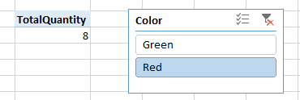

Implicit Filtering
Slicers
Cell Location

Slide 22

Explicit Filtering
GreenQuantity := CALCULATE(SUM(Sales[Quantity]), Sales[Color]="Green")
  Explicit filtering supersedes implicit filtering

Slide 23
Filtering Context
A combination of all the user filters
Basic filters are associated with specific, individual columns
CALCULATE allows you to overwrite the filter context

Slide 24
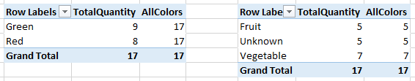
Removing Filtering
The ALL() function removes filters
Can be used on a whole table, or specific columns
AllColors:=CALCULATE(SUM(Sales[Quantity]), ALL(Sales[Color]))

Slide 25
Applying complex filtering
This causes an error:
  CALCULATE(SUM(Sales[Quantity]), Sales[Price] - Sales[Cost] <= 1)
Need to use something called an “iterator”
FILTER() takes in a table and an expression
  Returns a filtered table

Slide 26
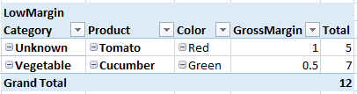
Example FILTER()
LowMargin:=CALCULATE(SUM(Sales[Quantity]),FILTER(Sales, Sales[Price] - Sales[Cost] <= 1))

Slide 27
Iterators
Process tables row by agonizing row
  Expensive to process
Rows are filtered one at a time.
  Called a row context
Often a filter context AND a row context is applied
Necessary to refer to multiple fields in the same row
  SUM(Sales[Price] - Sales[Cost]) raises an error

Slide 28

Example Iterator
AverageGrossMargin1:=AVERAGE(Sales[GrossMargin])
AverageGrossMargin2:=AVERAGEX(Sales, Sales[Price] - Sales[Cost])
  Requires a table parameter to “iterate” through
  Iterators are expensive

Slide 29
Key concepts
Calculated columns are materialized values in a table
Measures look at all the data plus the filter context
Explicit filtering overrides implicit filtering
DAX is optimized for single-column operations
Rows don’t exist, but row contexts do
Multi-column operations require iterators, which are expensive
CALCULATE() + FILTER() / ALL() can be used to apply advanced filtering

Slide 30
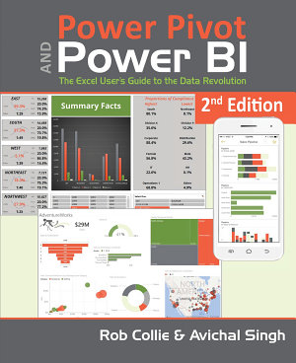
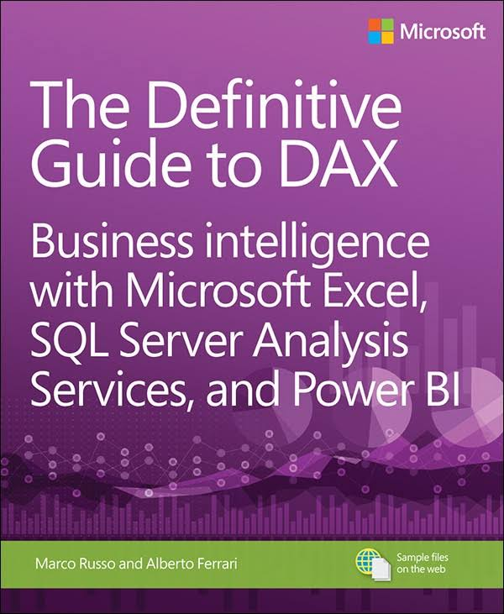
Book Recommendations

Slide 31
Questions?
Contact Info
@sqlgene
www.sqlgene.com/powerbi/
emeidinger@all-lines-tech.com

