Slide 1
Power BI: Getting Started and Keeping Up
Eugene Meidinger
@sqlgene
www.sqlgene.com/powerbi/
emeidinger@all-lines-tech.com

Slide 2
About me
Business Intelligence Developer
Certified in Querying and Administering SQL Server
Spoken at Pittsburgh SQL User Group and various SQL Saturdays
Pluralsight Author
Worked for All-Lines / Lantek for 5 years
Went from SQL newb to SQL pro

Slide 3
All Lines/LANtek is a local woman owned solutions provider that delivers cost effective, industry standard IT solutions to our customers.
We strive to be a Professional Business Partner and Trusted Advisor with each of our clients. We help companies streamline and improve the way they buy, implement, and manage their technology infrastructures that support their mission critical business applications.

Slide 4
Our Services
All Lines/LANtek is the only IT Services company in the region able to deliver the full range of services we can. From hardware to hosting we can keep your business efficient and in top production.
Managed Services
IT Consulting
Microsoft Solutions
IT Staffing
Enterprise Infrastructure
Our programs will reduce IT costs, improve
performance of the network, and assure a consistent level of service.
We provide assessment, design, implementation, management,
monitoring, and computer support services for all business computing needs.
We provide IT staffing
services for a variety of industries in the local market including manufacturing,
finance, healthcare, among others.
We provide proofs of concepts and assessments in all of these areas. We can also provide demos on site at our data center in Warrendale.
SharePoint and Office 365 give you and the people you work with a better way to get
things done together.

Slide 5
What are we going to cover?
Key resources for getting started
Key resources for keeping up
Overview of everything else

Slide 6
Why is this presentation necessary?
Power BI is a new technology
It changes every week
Resources are scattered
There are fewer resources than SQL Server

Slide 7
Getting Started– What is it good for?
Power Query
Collecting data
Cleaning data
Dax
Aggregating data
Filtering Data
Power BI visuals
KPI’s
Dashboards

Slide 8
Getting Started - Initial Resources
Edx course
Introduction to Power BI book
Power BI and Power Pivot book
Power BI Documentation

Slide 9
Course – Analyzing and Visualizing Data with Power BI
https://www.edx.org/course/analyzing-visualizing-data-power-bi-microsoft-dat207x-3
Free course
Part of Microsoft’s Professional Program in Data Science
Great way to get hands on experience

Slide 10
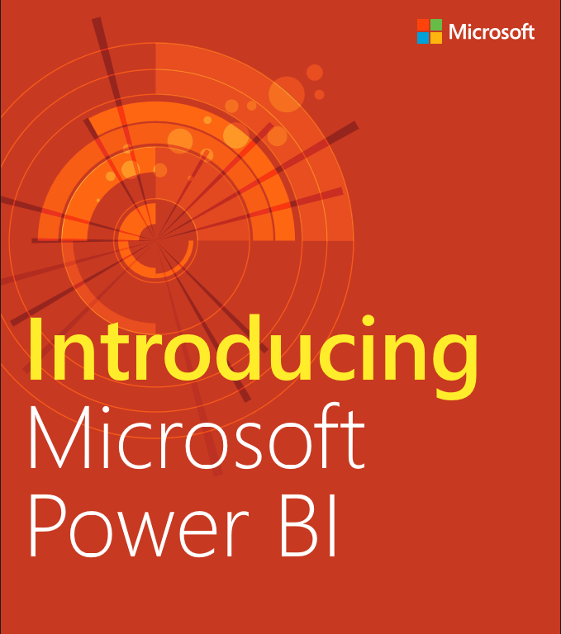
Book – Introducing Microsoft Power BI
Free book
Covers the basics
Very entry level
Surprisingly detailed

Slide 11
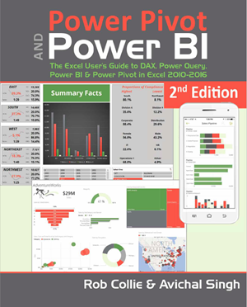
Book – PowerBI and Power Pivot
Easy read
Great introduction
I prefer the first edition

Slide 12
Keeping up
Monthly recap
Gilbert Quevauvilliers – BI blog
Power BI Webinars
Learn the fundamentals of DAX

Slide 13
Everything else
Books
Blogs
Videos
User Group (YAY!)

Slide 14
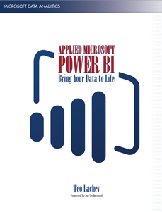
Book – Applied Power BI
Very thorough
Focuses on Power BI as a tool
A heavy read

Slide 15
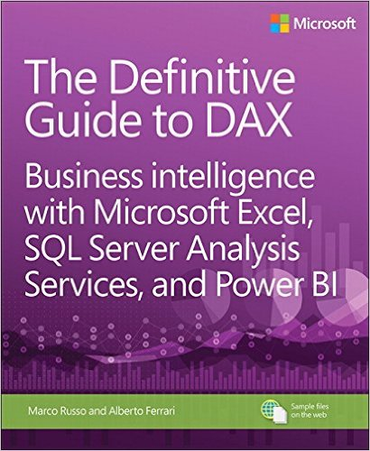
Book – The Definitive Guide to DAX
Good book
Very comprehensive
500 pages!

Slide 16
Book – M is for (Data) Monkey
Consider if
Heavy user of M/Power Query
Don’t have strong SQL support
Written for Excel users

Slide 17
Blogs – Get a feed reader
Blogs are still important
Try Feedly (my favorite)
Other feed readers are available

Slide 18
Blogs
Alberto Ferrari & Marco Russo
Chris Webb
Rob Collie
Kasper De Jonge
Ken Puls
Teo Lachev

Slide 19
Videos
Microsoft on Youtube
Pragmatic works
PowerPivot Pro
Guy In a Cube / Adam Saxton
PASS BI virtual Chapter

Slide 20
User Group
Next meeting Nov 17th
Introduction to DAX
Looking for more speakers
What do you want to learn about?

